Slide 1








From rivers to the ocean:
Using habitat models to understand and predict variations in central California salmon
Eric Danner
NOAA Fisheries
NOAA
Brian Wells
Steve Lindley
Andrew Pike
Lynn Dewitt
Mark Henderson
NASA Ames
Rama Nemani
Forrest Melton
Remote Sensing Solutions
Yi Chao
MBARI
Francisco Chavez
Monique Messié
University of Maine
Fei Chai
Shivanesh Rao
University of California Santa Barbara
Roger Nizbet
Ben Martin
Laure Pecquerie
California Department of Water Resources
Eli Ateljevich
Kijin Nam
Romberg Tiburon Center for Environmental Studies
Dick Dugdale

Slide 2
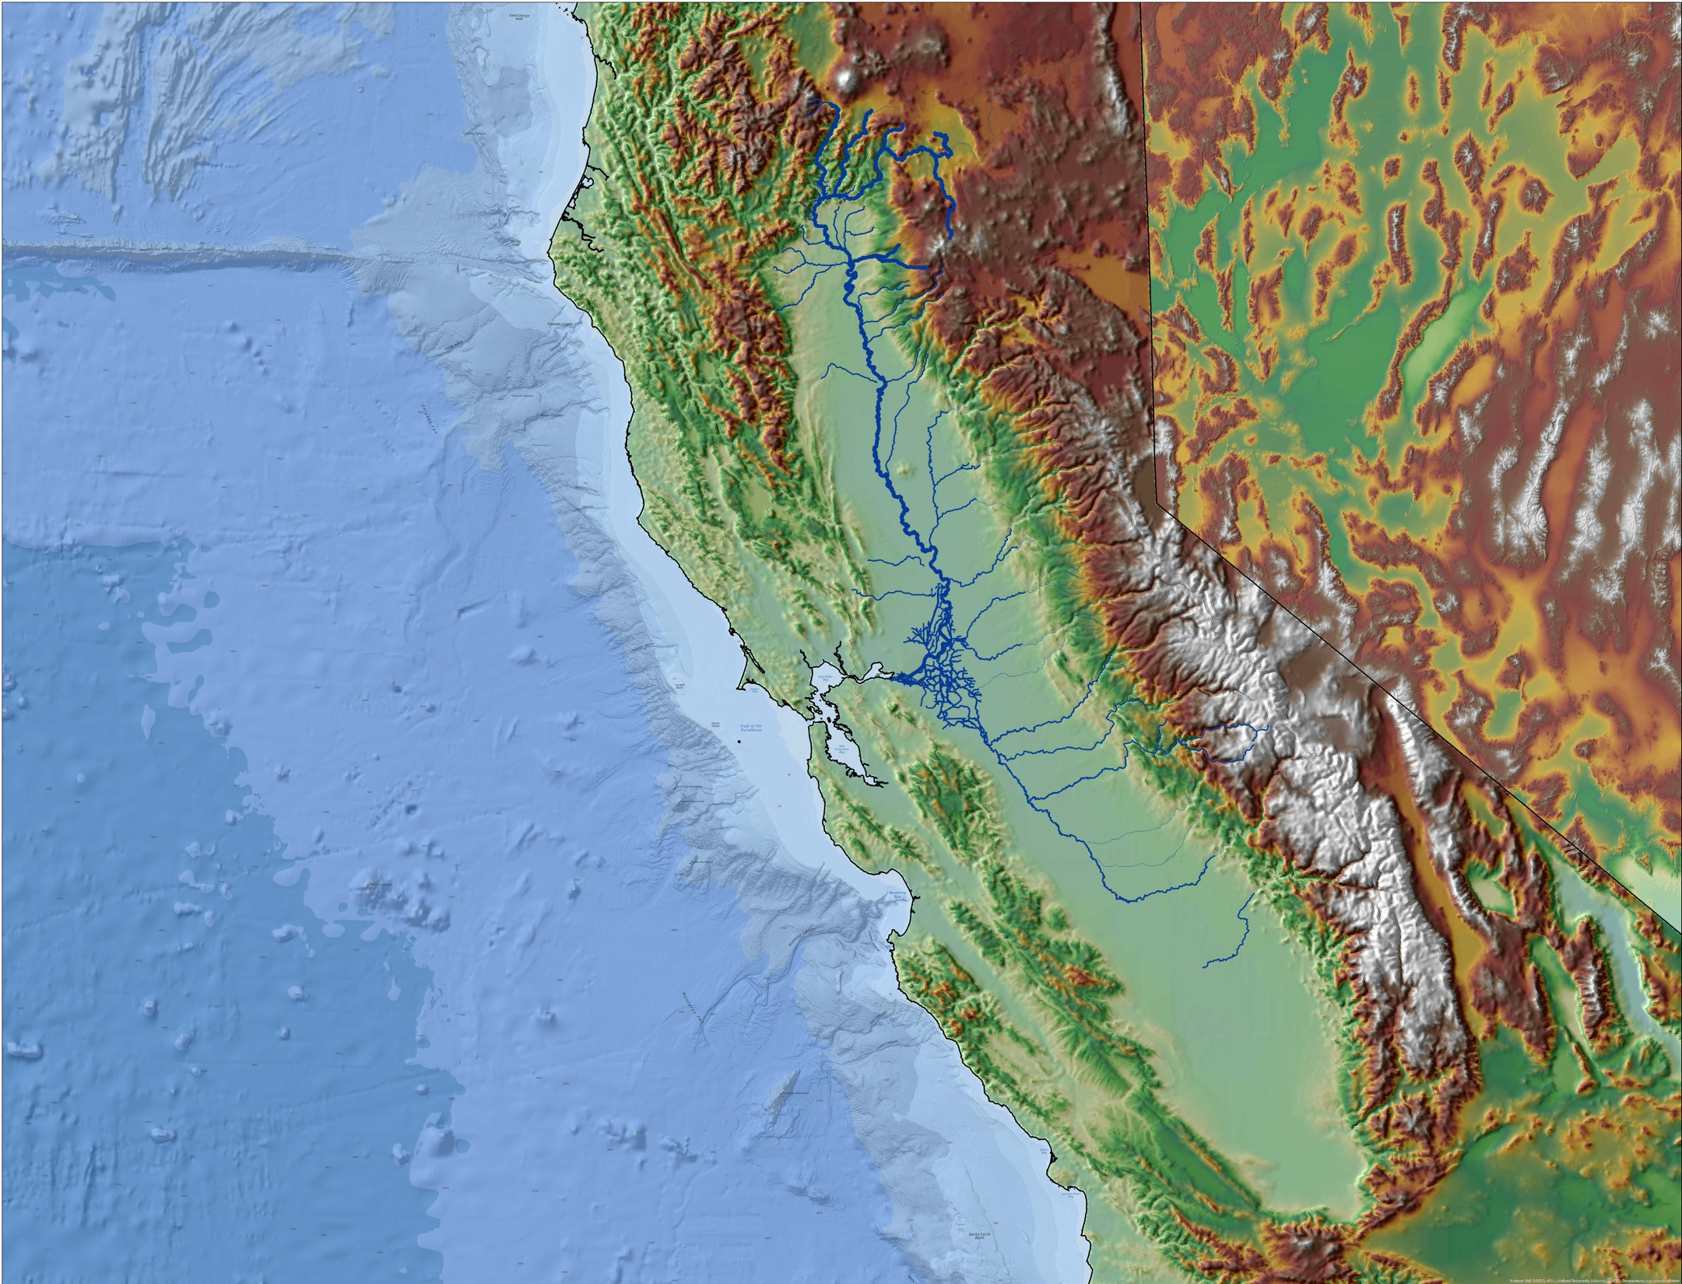
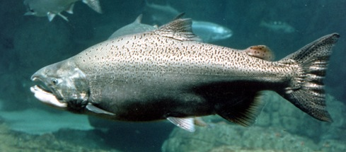
Credit: NOAA NMFS

Slide 3
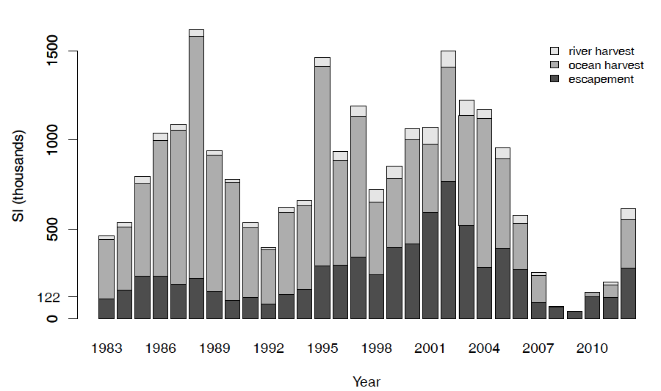

Slide 4
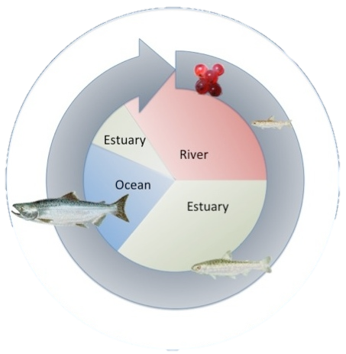
How to assess the quantity and quality of habitat?
Water velocity
Water temperature
Food density
2. How to model these values over this large and complex landscape?

Slide 5
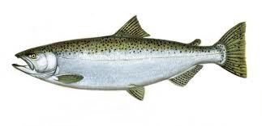
Dynamic Energy Budget (DEB) Models
Feeding
Input
Food
Temperature
Velocity
Output
Growth
Fecundity
Migration costs
Embryonic dev.
Age at maturity
Maintenance
Maintenance
Growth
Maturation
Reproduction

Slide 6
RAFT
AQUATOX
Sacramento River
SELFE
CoSiNE
San Francisco Estuary
ROMS
CoSiNE
Coastal Ocean

Slide 7
Coupled Physical-Biological Models
RAFT
AQUATOX
Sacramento River
SELFE
CoSiNE
San Francisco Estuary
ROMS
CoSiNE
Coastal Ocean

Slide 8
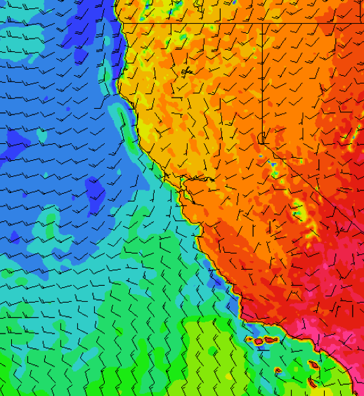
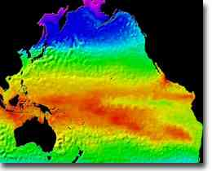
Coupled Physical-Biological Models
RAFT
AQUATOX
Sacramento River
COAMPS
SELFE
CoSiNE
San Francisco Estuary
ROMS
CoSiNE
ROMS
Coastal Ocean

Slide 9
Coupled Physical-Biological Models
RAFT
AQUATOX
Sacramento River
Food
Temperature
Velocity
COAMPS
SELFE
CoSiNE
Salmon DEB Model
Eggs / Juveniles / Adults
San Francisco Estuary
Food
Temperature
Velocity
ROMS
CoSiNE
ROMS
Coastal Ocean
Growth
Fecundity
Migration costs
Embryonic dev.
Age at maturity

Slide 10
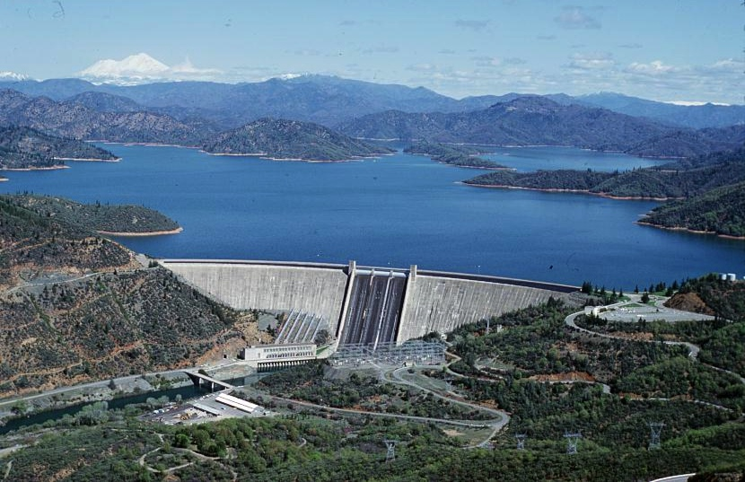
Upstream Boundary
Reservoir operations
Climate models
Watershed models
Reservoir models
Temperature
Flow

Slide 11
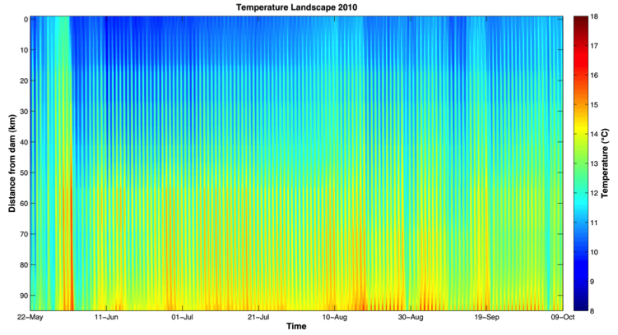
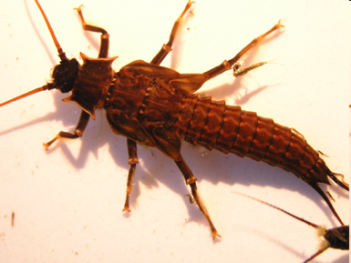
River Habitat
Temperature
Flow
RAFT
Physical Model
AQUATOX
Ecosystem Model
Temperature
Flow
Temperature
Velocity
Aquatic Insect and Zooplankton Biomass
Temperature
Flow
Salmon DEB Model
eggs, alevin, fry, smolts, adults

Slide 12
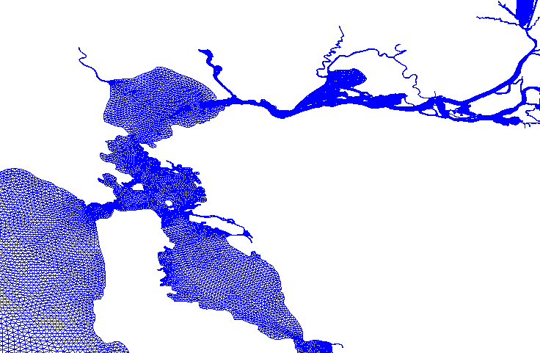
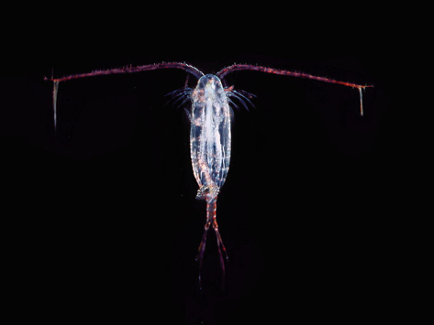
Estuary Habitat
Temperature
Flow
Zooplankton
Nutrients
SELFE
Physical Model
CoSiNE
Ecosystem Model
Temperature
salinity
sea level
currents
nutrients carbon oxygen
Temperature
salinity
sea level
currents
nutrients carbon oxygen
Temperature
Velocity
Zooplankton Biomass
Salmon DEB Model
tidal fry, smolts,
adults

Slide 13
Ocean Habitat
Temperature
salinity
sea level
currents
Zooplankton Biomass
nutrients carbon oxygen
ROMS
Physical Model
CoSiNE
Ecosystem Model
Velocities mixing temperature light
Zooplankton Biomass
Temperature
Velocity
Salmon DEB Model smolts, subadults

Slide 14
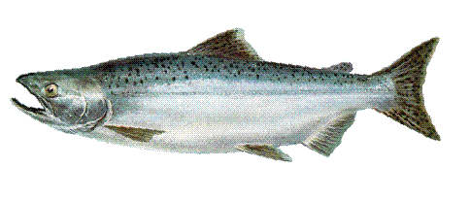

Slide 15
DEB Model: River Habitat
Velocity
Temperature
Size
Energy spent on migration cannot be spent elsewhere
= smaller eggs

Slide 16
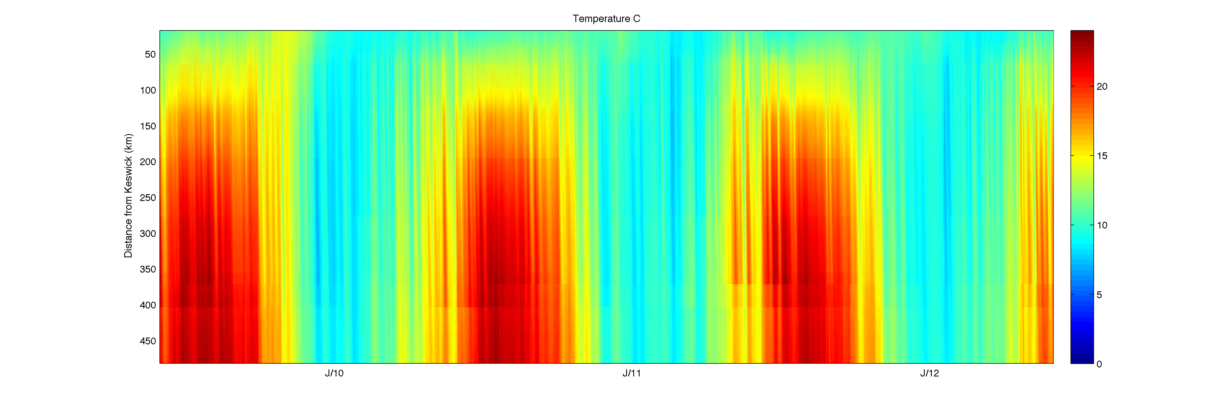
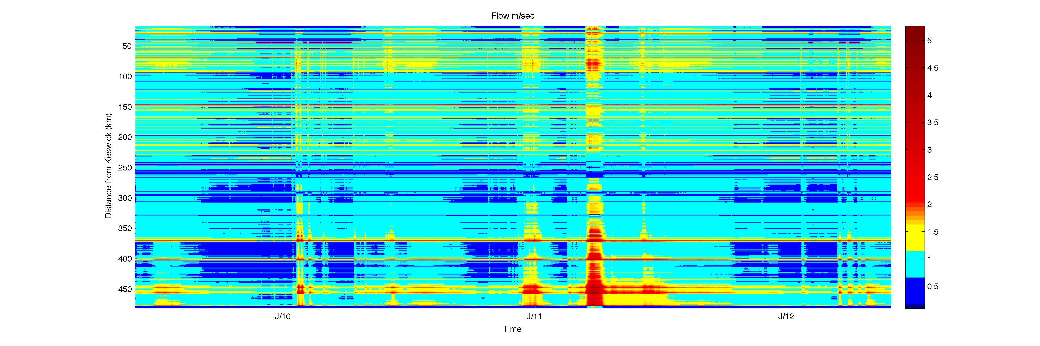
Physical Model: River Habitat
Distance from dam
Temperature
Distance from dam
Flow velocity (m/s)
Time

Slide 17
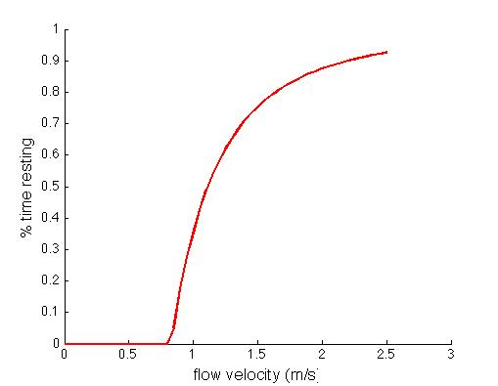
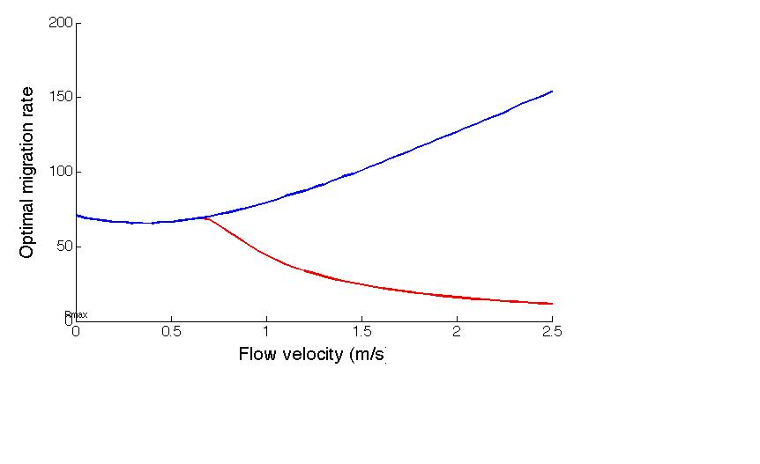
DEB Model: River Habitat
Not-endurance limited
Optimal migration rate (km/day)
Fraction of time recovering
Endurance limited
Flow velocity (m/s)
Flow velocity (m/s)
Hydrodynamics-based power-law equation
Critical power model

Slide 18
DEB Model: River Habitat
Adult salmon migrations: velocity and temperature

Slide 19
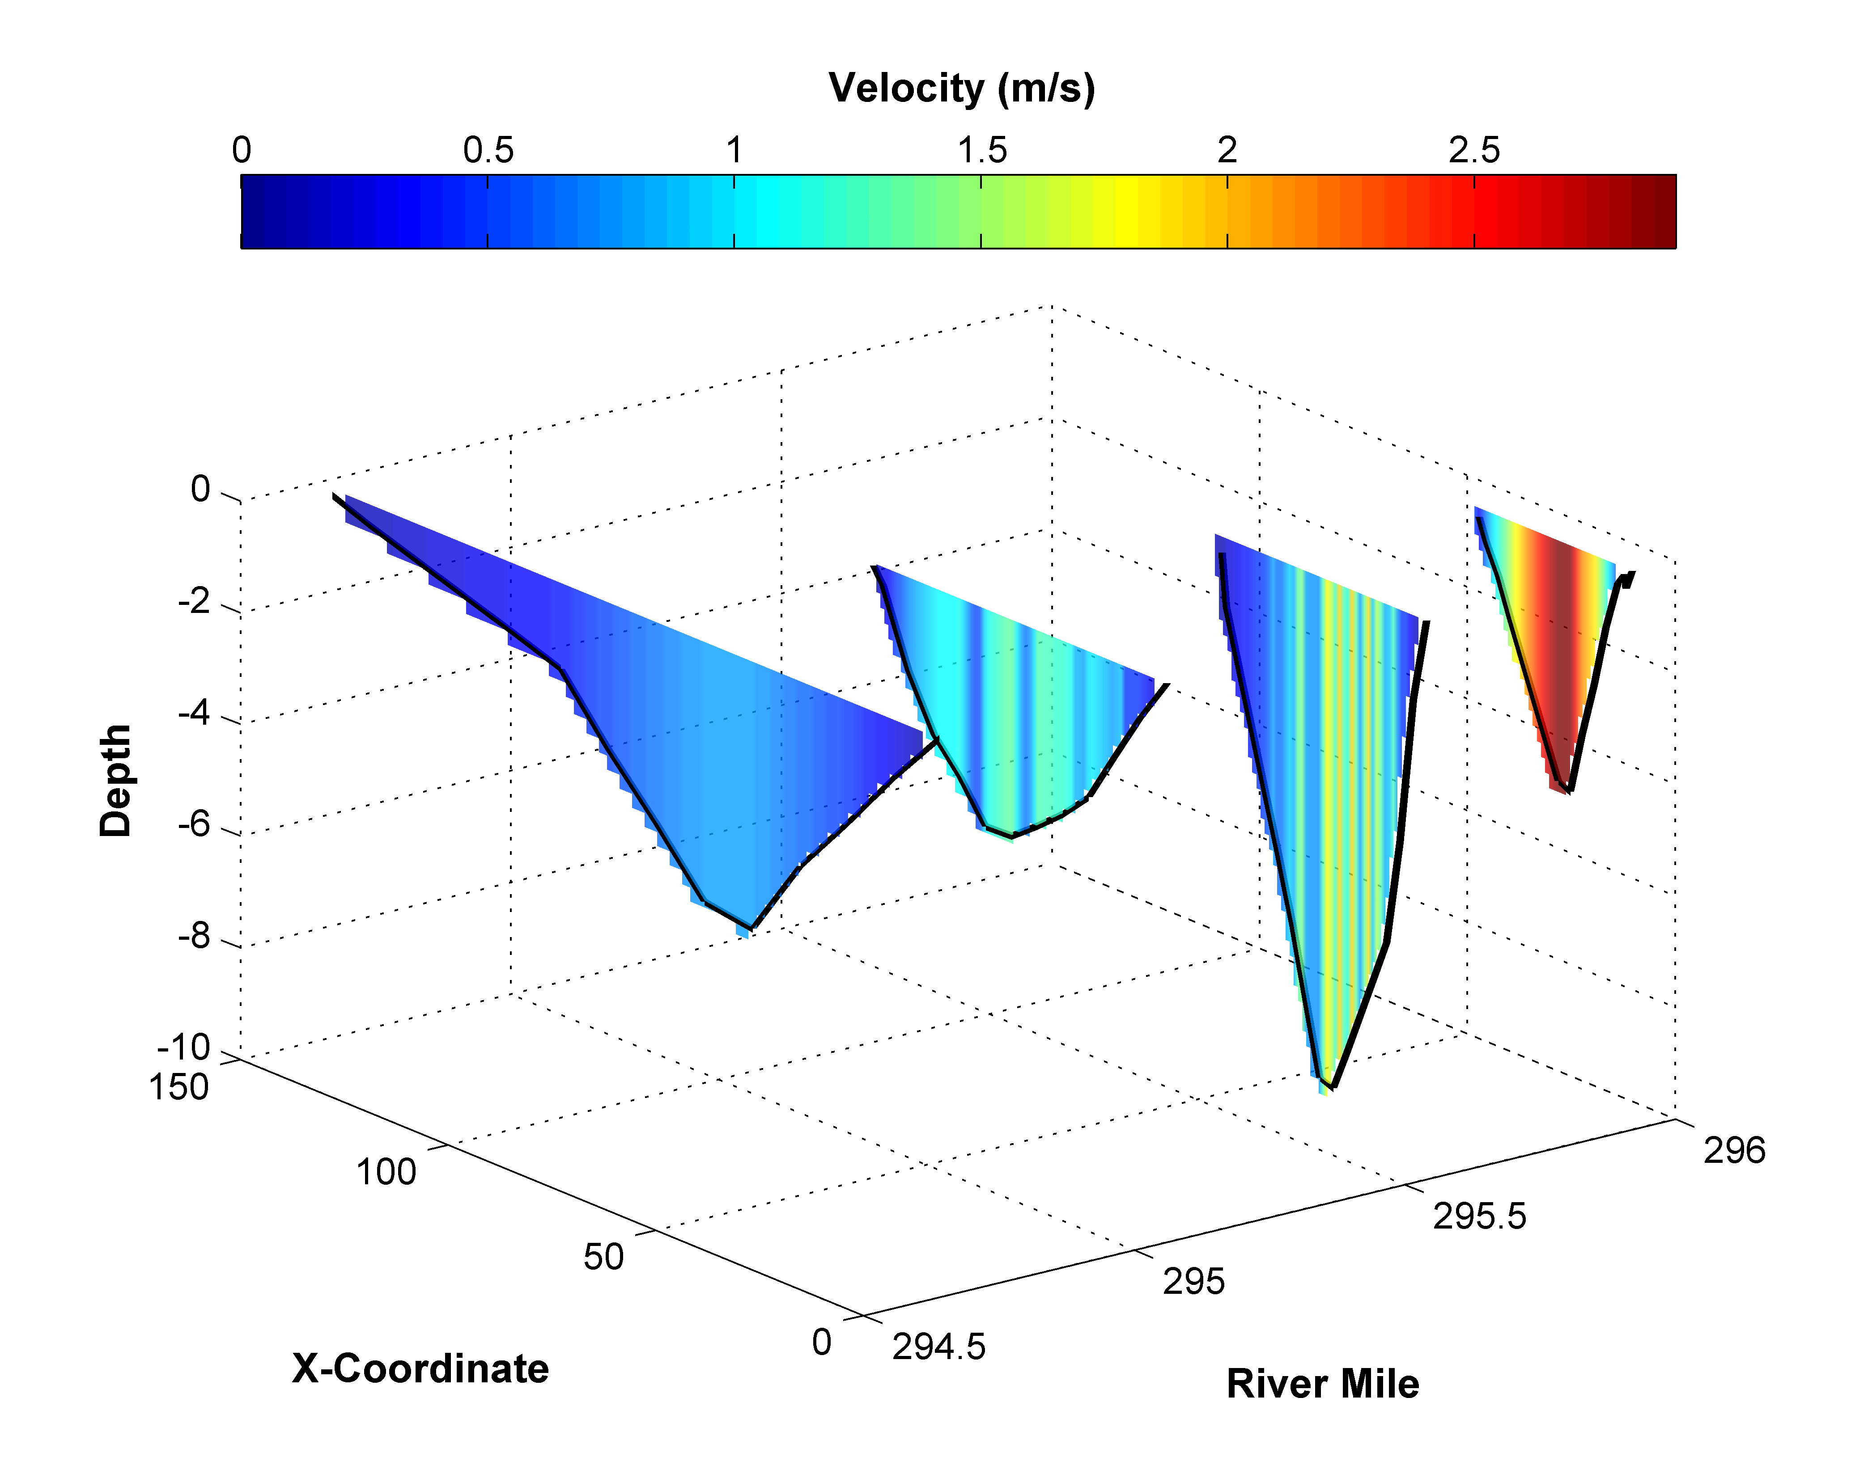
DEB Model: River Habitat

Slide 20
DEB Model: River Habitat
with endurance limit
without endurance limit

Slide 21
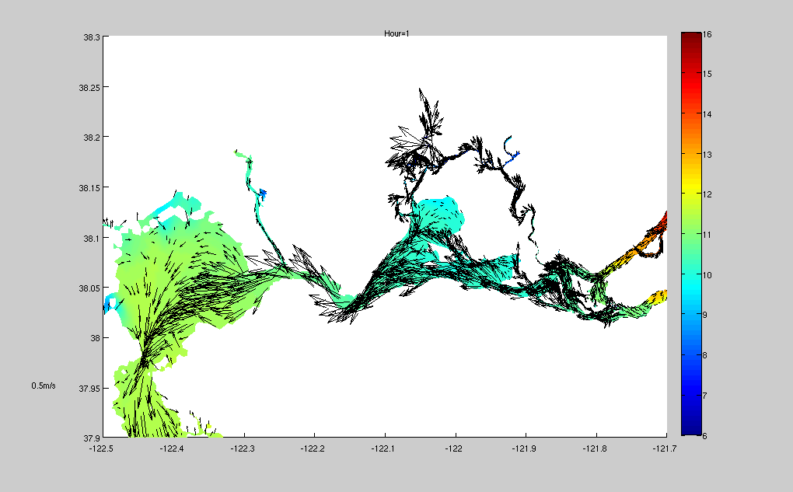
Physical Model: Estuary Habitat
Temperature

Slide 22
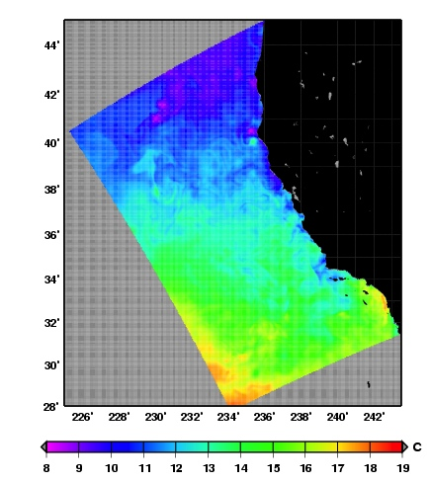
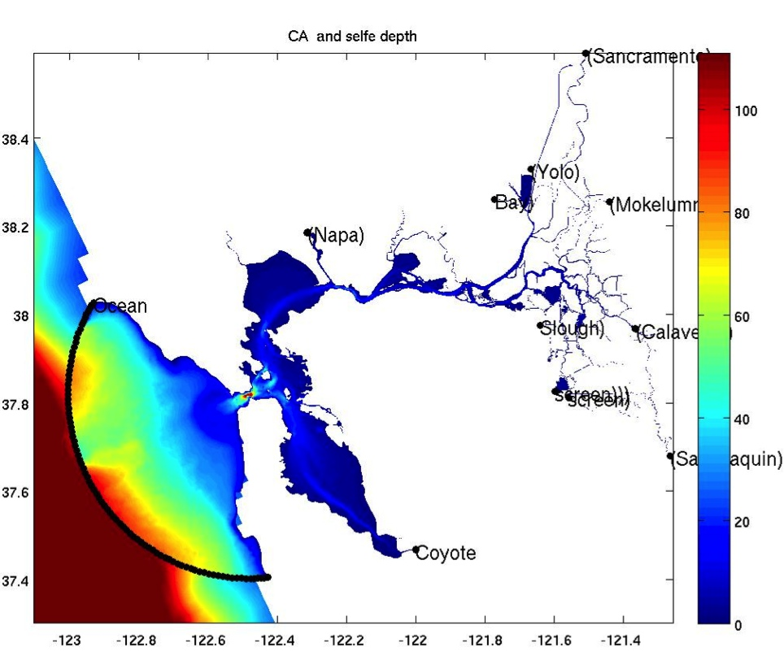
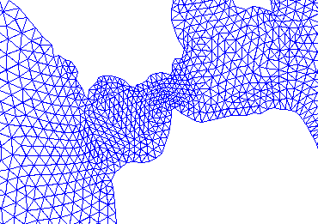
Physical Model: Estuary Habitat
Linking California coastal ocean model with
San Francisco Bay/Estuary model
Golden
Gate
ROMS
3-km
Unstructured grid SELFE
1-km………………..10-m

Slide 23
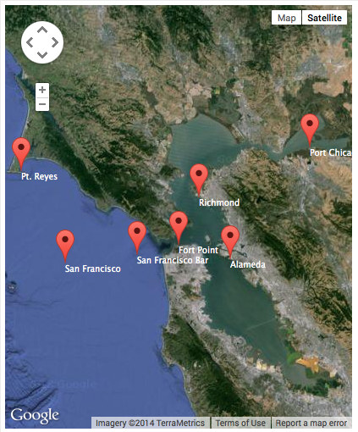
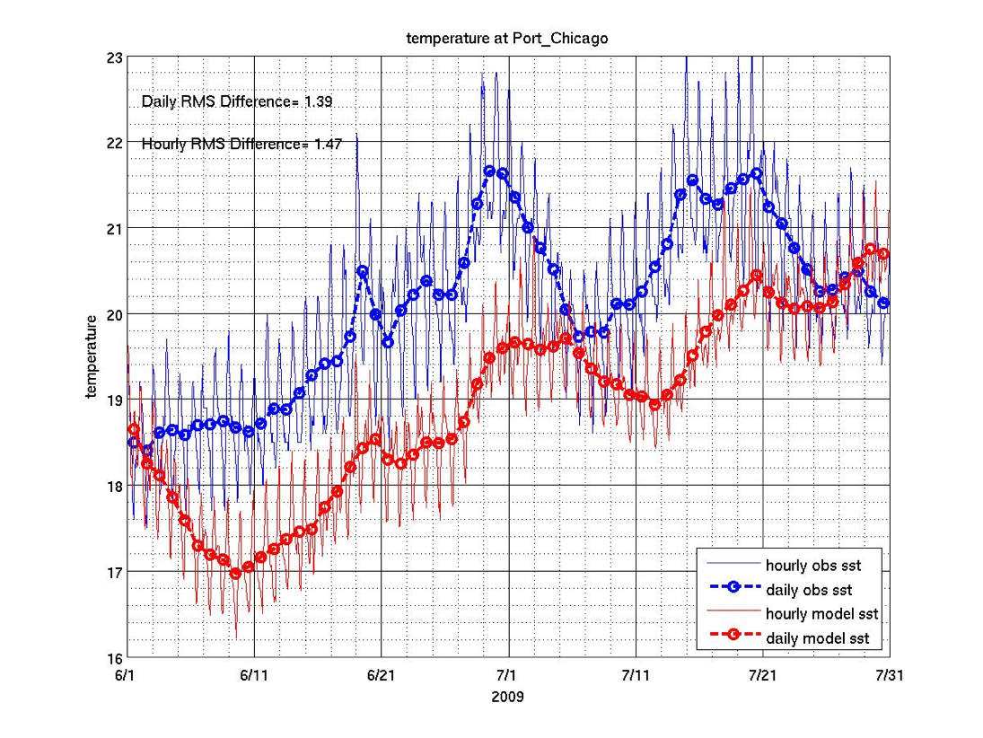
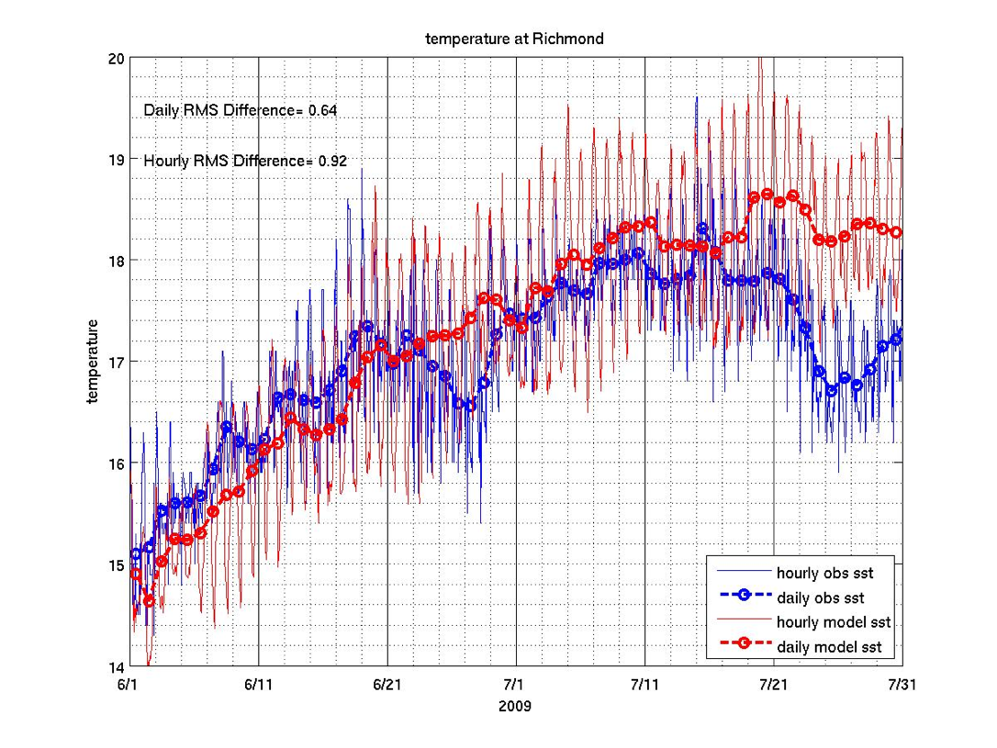
Temperature

Slide 24
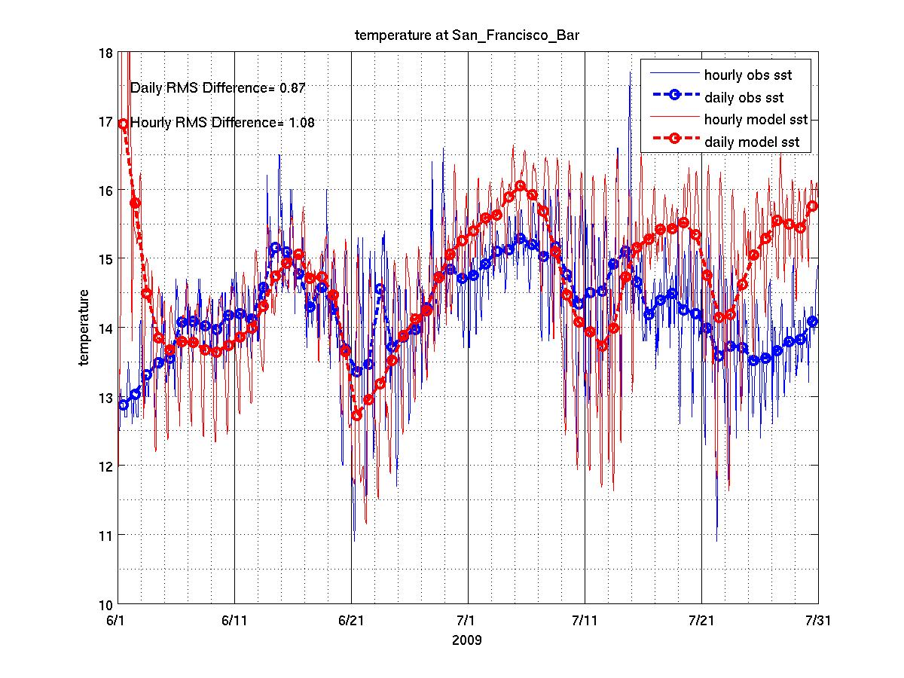
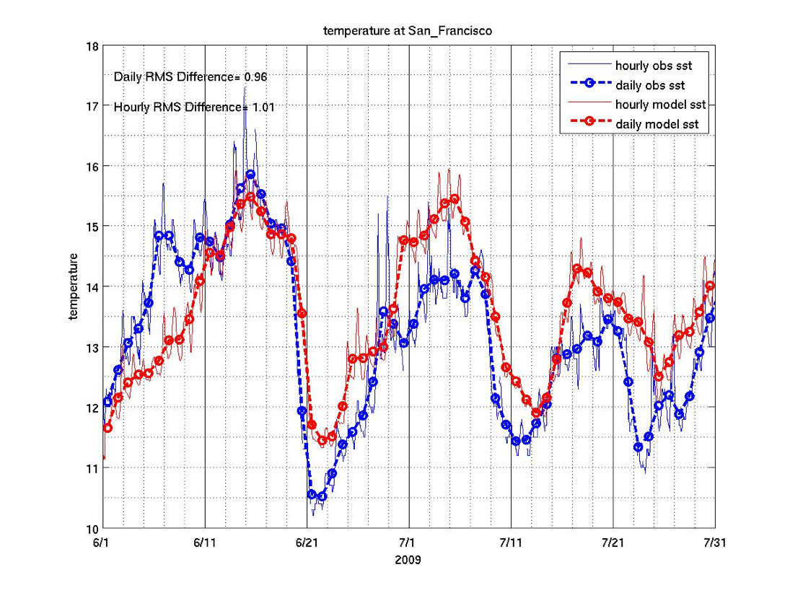
Temperature

Slide 25
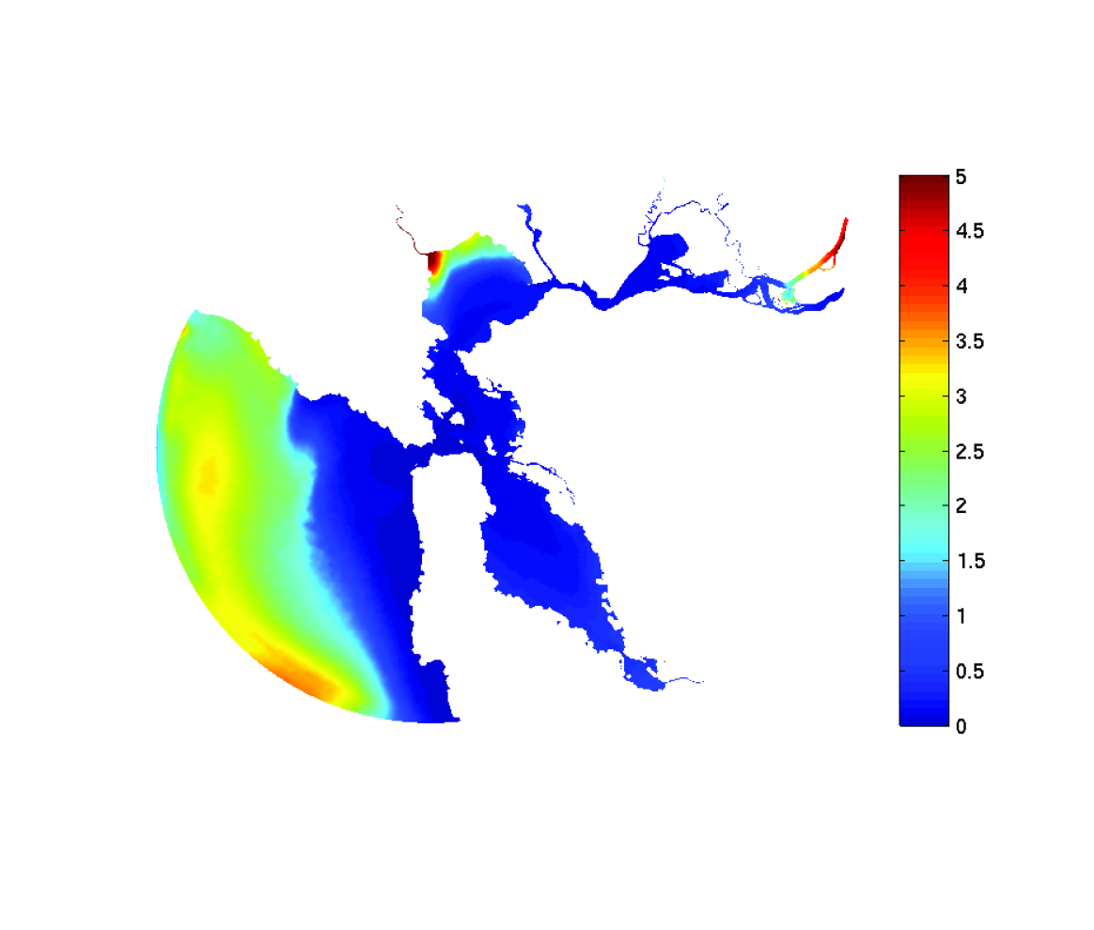
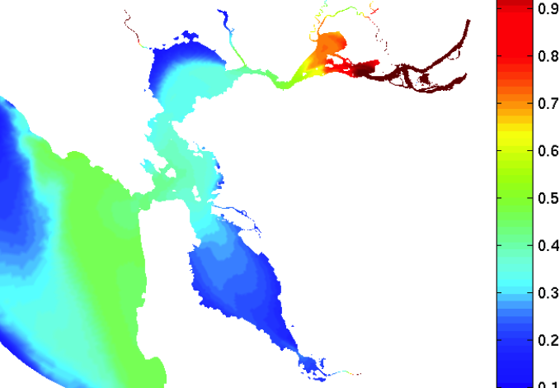
Biological Model: Estuary Habitat
NH₄ concentration (m.mol/m³)
Chlorophyll (m.mol/m³)
Successfully integrated CoSiNE with SELFE
Need to revise the NO₃ uptake curve in CoSiNE

Slide 26
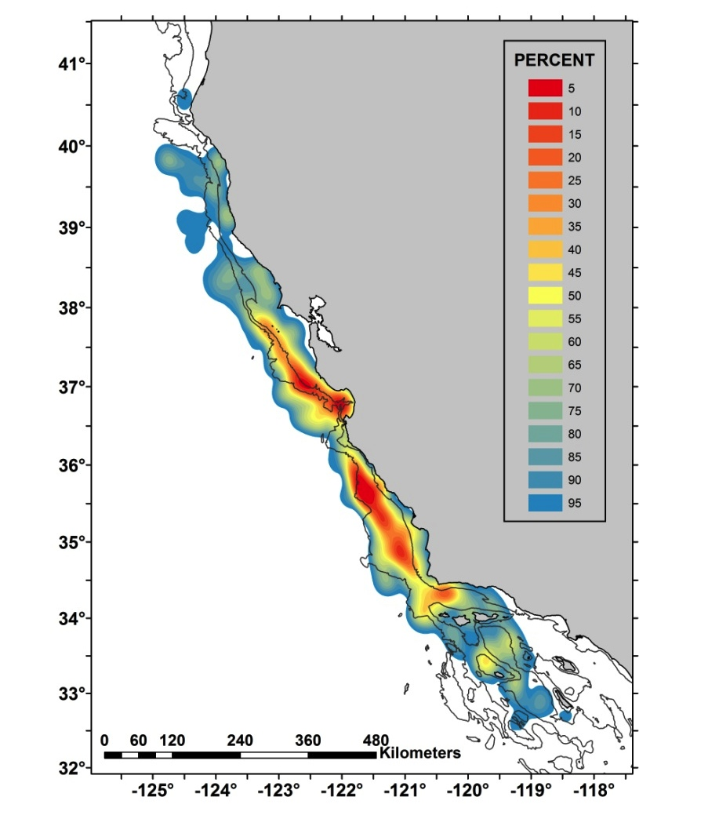
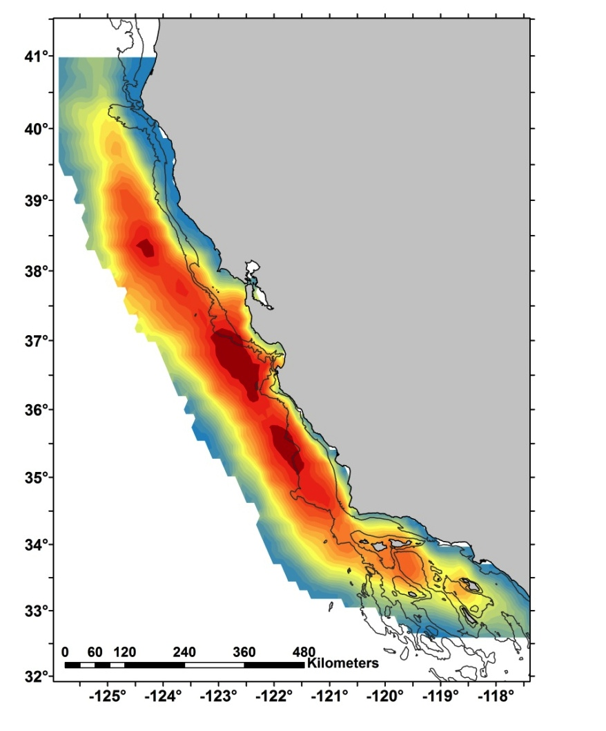
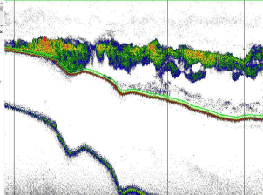
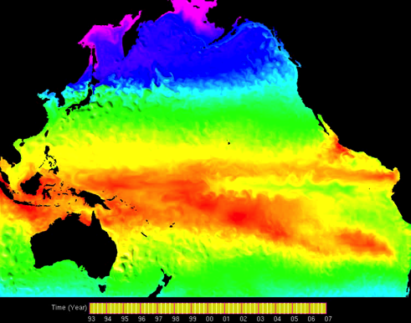
Biological Model: Ocean Habitat
environmental variability
Observed krill
Modeled zooplankton

Slide 27
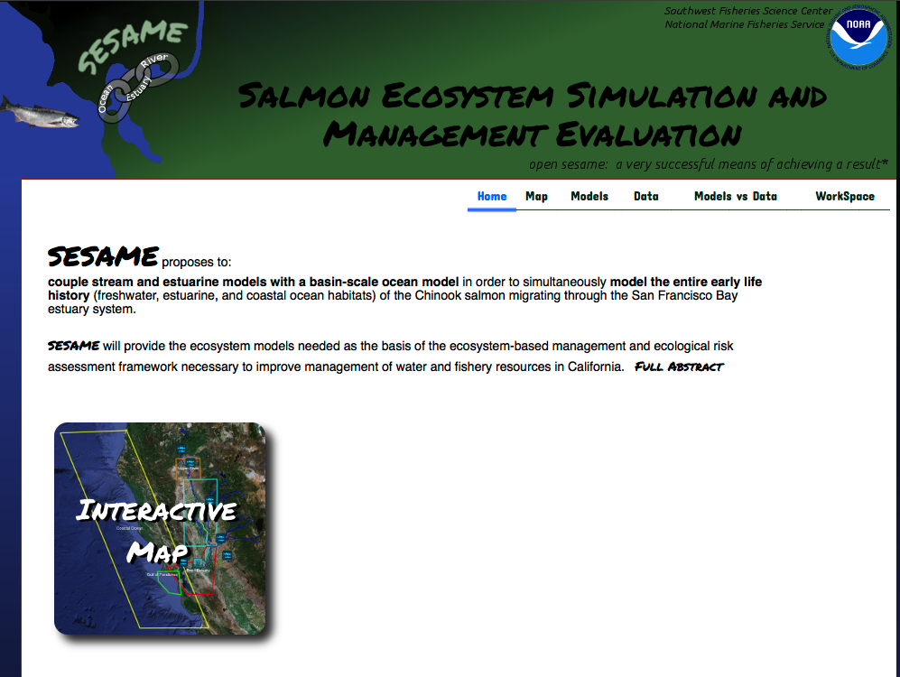
http://sesame.noaa.gov/

